Slide 1

QuakeFix
Not just a risk map: a human-approved action plan.
Multi-Hazard Urban Resilience & Emergency Orchestration Platform
Byte Debuggers | IBM Z Datathon 2026 | Real-Time AI for Critical Decisions
Notes:
Cover. Replace [Team Name] with the real team name. Project title for submission: [Team Name_IBM Z Datathon 2026 Project].

Slide 2




The problem: one quake, five failures
Must prove: disasters cascade, but emergency tools treat each hazard in its own silo.
→
→
→
→
Earthquake
Gas line ruptures
Water mains burst
Roads collapse
Hospitals overwhelmed
When an earthquake strikes, the shaking is only the start. Gas lines rupture, water mains burst, floods follow, roads collapse, and hospitals are overwhelmed, all at the same time. But emergency software tracks each of these in its own silo. Commanders have to piece together seismic feeds, utility status, road conditions and hospital capacity by hand, under extreme time pressure. Every minute spent reconciling data is a minute not spent saving lives.
Notes:
Problem slide. Keep to ~25 seconds in the video. Only add a statistic if you can cite a source.

Slide 3




Who it helps
Must prove: four real roles decide faster from one view, and evacuating citizens get safer routes.
Emergency commanders
Dispatchers
Field medics
Utility operators
Approve utility isolation, evacuation, deployment
Assign ambulances to safe routes and open hospitals
Get compact SMS/CSV actions when networks fail
Early warning to isolate gas and water sectors

Slide 4
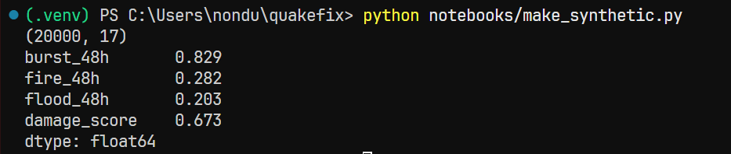



The data behind it
Must prove: real public feeds plus clearly labelled simulated utility data.
USGS seismic feed
OSM + DataSF
Live magnitude, depth, location
Road network and city building footprints
SYNTHETIC
PARTLY SIMULATED
Utility telemetry
Hospitals + safe zones
Pressure drops, pipe age, elevation (simulated)
Ambulance and evacuation targets; beds simulated

Slide 5
Our solution
Must prove: QuakeFix is different, and it turns data into decisions.
Most emergency tools show earthquakes, utilities, roads and hospitals separately; QuakeFix links them into one cascade and turns it into human-approved actions, running on IBM LinuxONE.
Ingest
USGS + OSM
Process
Pandas / GeoPandas
Predict + Route
XGBoost + NetworkX
Serve
FastAPI
Decide
Streamlit map UI
→
→
→
→
4 hazards: pipe burst, fire, flood, structural damage | 2 routing modes: ambulance and citizen evacuation

Slide 6
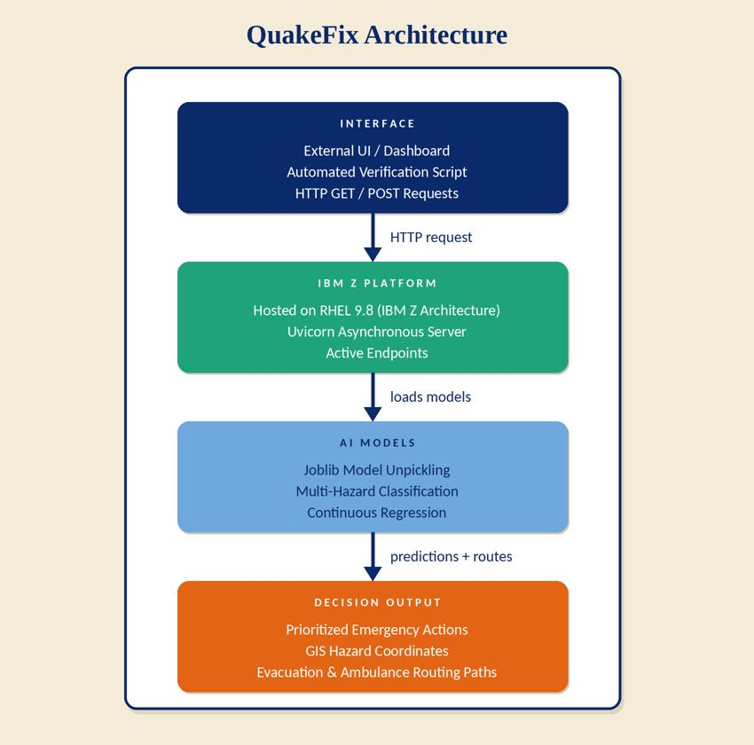


Architecture
Must prove: the design is sound and every layer has a clear job.
[Insert architecture_diagram.png here: Insert > Pictures > This Device]
Ingest
USGS, OpenStreetMap, DataSF
Predict
4 hazard models (classification + regression)
Route and decide
Ambulance and evacuation paths; commander approves

Slide 7
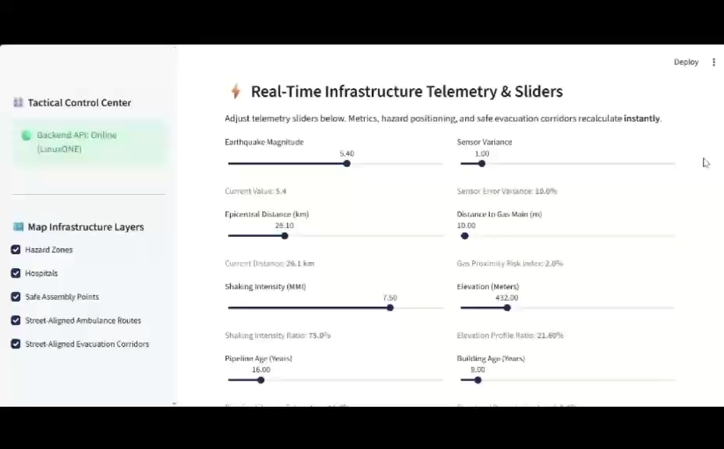
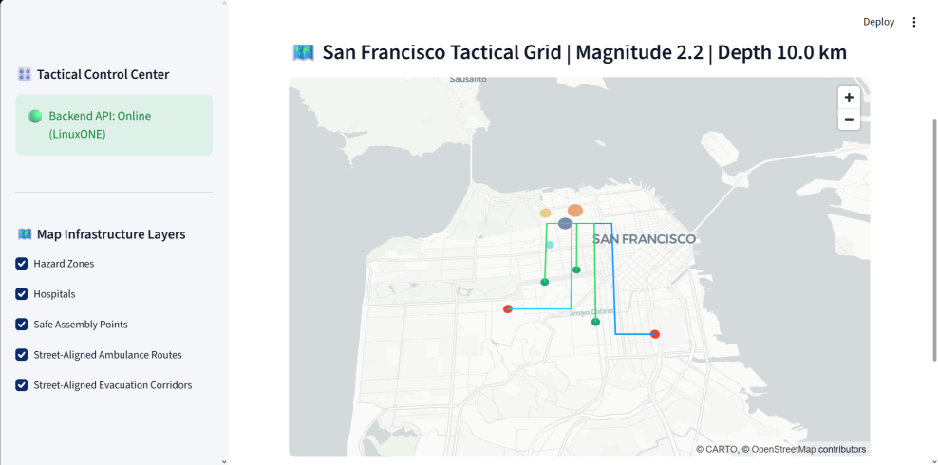
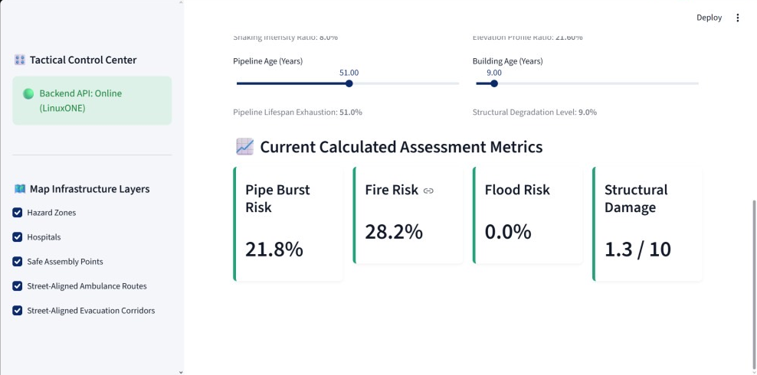
Live demo
Must prove: event in, prioritised directive out, human decides.
[Insert screen recording here: Insert > Video > This Device. Event in, directive out, commander decides.]
Command map: hazard zones, hospitals, safe points, routes
Live risk prediction: burst, fire, flood, damage

Slide 8
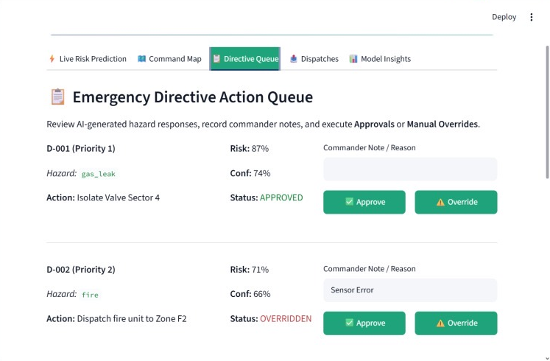
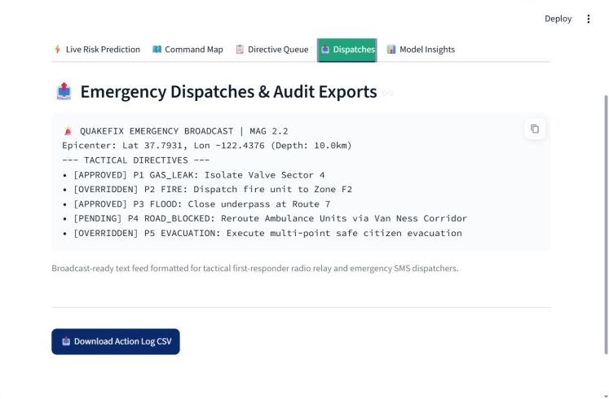
Human control and field relay
Must prove: a commander decides every action, and field teams get a compact relay.
Directive queue: each action shows risk and confidence. The commander approves or overrides and records a reason.
Dispatch tab: a compact broadcast for radio and SMS, plus a downloadable audit log.

Slide 9
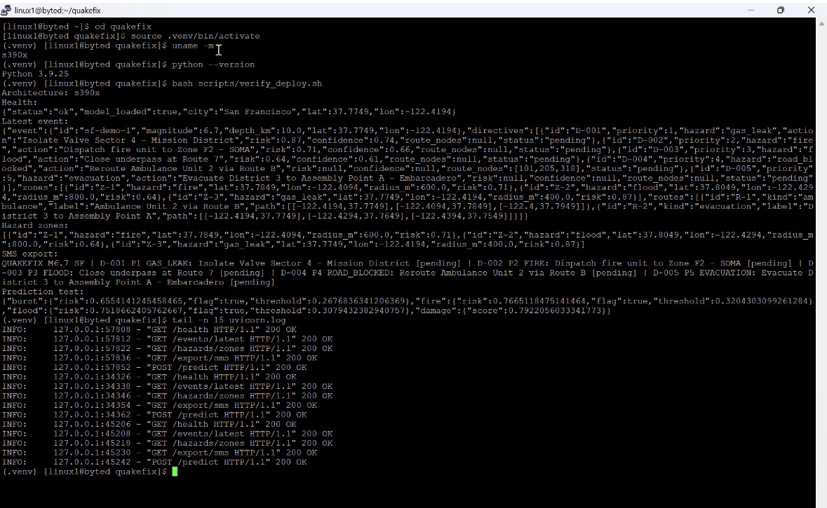



Built on IBM Z
Most important slide. Must prove: LinuxONE is used meaningfully, not just as hosting.
Runs on IBM LinuxONE (s390x architecture)
Uvicorn async server, FastAPI endpoints
Joblib models: multi-hazard classification + regression
Data stays inside the deployment boundary
Evidence from the LinuxONE server: architecture s390x, API healthy, model_loaded true, and a live prediction for burst, fire, flood and damage.

Slide 10
Model results
Must prove: each hazard is evaluated on what matters. A missed hazard costs more than a false alarm.
Pipe burst
Fire
Flood
Structural damage
Precision [21.8%]
Recall [79.2%]
F1 [13%]
Precision [28.2%]
Recall [71.8%]
F1 [15%]
Precision [0.0%]
Recall [100%]
F1 [0.0%]
Error (MAE) [1.3/10]
R2 [8.7/10]

Slide 11
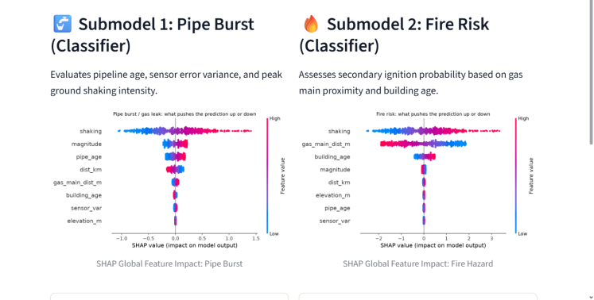
Explainable predictions
Must prove: every hazard prediction can be explained to a commander.
What the charts show
Each hazard has its own model.
Pipe burst: shaking, magnitude and pipe age push risk up the most.
Fire: shaking, distance to a gas main and building age matter most.
SHAP charts show which factors raised or lowered each score, so a commander can see why a zone was flagged.

Slide 12




Responsible AI
Must prove: people stay in control, and we are honest about limits.
Human in the loop
Transparent
No directive runs without commander approval; override is always available.
Every directive shows a confidence score and top contributing factors.
Privacy first
Honest scope
Public, infrastructure-level data only. No personal data.
Data is simulated, map coverage varies, and evacuation routes cannot see live traffic.

Slide 13
Impact and limits
Must prove: faster coordinated action in the first minutes, and we know what we have not proven.
Impact
Honest limits
One prioritised view of cascading risk
Faster utility isolation
Safer ambulance routing
Safer evacuation routes for citizens
Synthetic utility data
Single-city demonstration area
No live link to real utility control systems
No live traffic or crowd data for evacuation
Decision support, not a prediction of record
QuakeFix targets the critical first minutes after a seismic event, when coordination matters most. One prioritized view of cascading risk means faster utility isolation, safer ambulance routing, and less exposure to secondary hazards. When cellular networks fail, compressed SMS and CSV summaries keep priority actions flowing to field teams.

Slide 14
Meet Team Byte Debuggers
Five members, one pipeline from data to decision.
Kamogelo Nondula
Yanelisa Mzizi
Luthando Rungqu
Nondumiso Mkhonto
Andile Ntombela
Member 1 | Group leader
Member 2
Member 3
Member 4
Member 5
Technical lead and integration
Data engineering and analysis
Machine learning and decision science
Prototype and user experience
Impact, responsible AI and pitch

